Slide 1
Welcome to Your
JUNIOR
College and Career Readiness Interview

Slide 2
KEYS TO SUCCESS
Attend school every day!
Focus on academics.
Get involved in clubs and/or organizations: holistic applications
Start long-term planning.
Prepare to take standardized tests (ACT and SAT).
Use your resources: www.uintahcounseling.weebly.com

Slide 3
POINTS TO PONDER……
Time to finalize possible plans for post-secondary education – see website for resources
Every junior has the opportunity to visit with 3 colleges during College Tour.
All students are encouraged to visit colleges or other post-secondary schools - 2 excused absences per year (with note) for those visits.
Priority deadline for college applications and scholarships is December 1st.

Slide 4
Graduation!
Students MUST HAVE all required classes AND 26 credits total in order to graduate.
Each class is worth 0.5 credit.
A student can earn 2.5 credits each trimester by passing all of his/her classes.
Use your ASPIRE login to print out a Credit Evaluation.
If a student fails a required class or is lacking credits, there are several Credit Recovery Options: Night School, Summer School, or another online accredited option.
Notes:
24.5 credits required for graduation which must include these specific classes:
4 language arts; 2.5 social studies (Geo, W. Civ, US, Am Govt); 3 math (Math I, Math II, Math III); 3 science (Earth Sys., Bio,Chemistry, Physics); ½ Health, 1.5 PE; 1.5 Art; Financial Lit, Computer Technology, 2 CTE classes.
YOU as a parent, along with your student, are ultimately responsible for meeting those guidelines.

Slide 5
Keep Up!
Golden Time help sessions
Monday mornings, 8:00 – 9:00 am
Retake tests, get help with homework, get answers to
questions
Talk with teachers one-on-one
Study with a Buddy
Math Department Tutoring Program Monday-Friday, 2:30 – 3:30 pm, outside room U210
Kahn Academy
https://www.khanacademy.org/ Free academic tutoring online.

Slide 6
Shmoop
Every student has access to Shmoop – the state of Utah has paid for you to have an account.
You just need to know the magic word: HIKING
Shmoop has an essay builder and other resources to help you with assignments and homework.

Slide 7
Shmoop Essay Lab

Slide 8
CTE Pathways
Career and Technical Education provides critical learning and hands-on skills through Pathways within eight Areas of Study.
Career Pathways provide one way to “try out” a career and to find electives.
Pathways help students take 6 courses and/or an internship related to a career.
All CTE opportunities will be offered regardless of race, color, national origin, sex, disability or age.

Slide 9
UHS Majors
A major is a focus area offered at Uintah High School.
Seniors can download the application, complete it, pay $5 to finance, and turn it in to the proper department chair to receive the award at graduation.
Seniors may only apply for one major.
Majors include: English, Life Science, Physical Science, Math, PE/Health, Performing Arts, Visual Arts, Social Studies, and World Languages.

Slide 10
UBTech Classes
Must have less than 6 absences in the trimester before you take a UBTech class
Some medical classes require a 3.0 GPA and 2 credits each of Math and Science.
1 and 2 year certificates
Notes:
Intro to Health Sciences doesn’t require 2 credits of math and science

Slide 11
Concurrent Enrollment
Earn 0.5 credit high school credit per class and 3.0 college credits per class
Fees for enrollment ($50), registration ($5 a credit), and books (prices vary, shop around)
3.0 minimum GPA
Must inform high school teachers about your Monday schedule
Fridays – no USU classes – get an off-campus pass from Mrs. Norton in attendance

Slide 12
ACT
http://www.actstudent.org/
Free online preparation program: Shmoop https://schools.shmoop.com/login/uintah/uintah-high
Magic Word: HIKING
Utah Futures
All juniors will take the ACT at no cost on February 27, 2019.
Take it seriously!

Slide 13
NCAA
You must be registered to play college sports - $65 fee
http://web1.ncaa.org/ECWR2/NCAA_EMS/NCAA.jsp
Meet with your counselor to schedule the required classes.
Registration and class completion do not guarantee recruitment!
It is your job to contact colleges and be recruited.
Notes:
NCAA night in April

Slide 14
FAFSA Completion
Free Application for Federal Student Aid
www.fafsa.ed.gov/
It is important for everyone to complete a FAFSA application even if you don’t think you will qualify for federal grants
Schools use the FAFSA to award their own scholarships
Notes:
Plan on college application and FAFSA completion night in November during College Application week

Slide 15
Regents’ Scholarship
Must have 3.3 GPA, ACT 22
Must fill out the FAFSA
And take the required classes:
4 credits English
4 credits of progressive Math
3.0 credits of Social Science
3 credits of Science (must be Biology, Chemistry, and Physics)
2 progressive credits of the same Foreign Language
Notes:
It is your responsibility to check with Regents’ frequently to complete paperwork and meet their deadlines!

Slide 16
Scholarships www.uintahcounseling.weebly.com
Scholarship Opportunities
Scholarships are listed by month.
They are updated frequently.
You have to apply to receive scholarships!
Scholarship Searches
Register online.
Check frequently.
Notes:
Go to school’s website.

Slide 17
Registration
Class requests for your senior year (2019-2020) will be made today.
Schedule changes can be made by students at the end of the school year, before school begins, and before each trimester begins.
Any class changes made by a counselor at any time will be assessed a $10 fee.

Slide 18
SHORT-TERM PLANNING FOR THE IMMEDIATE FUTURE
Plan on attending a meeting with your counselor at the beginning of your senior year to make goals for your future.
Be knowledgeable about how to achieve success.
Be responsible for important information and details.

Slide 19
Boys and Girls State
Earn Political Science college credit
Meet students from all over the state
Spend time on Weber State Campus
Girls – June 3-8, 2019
Boys – June 10-14, 2019

Slide 20
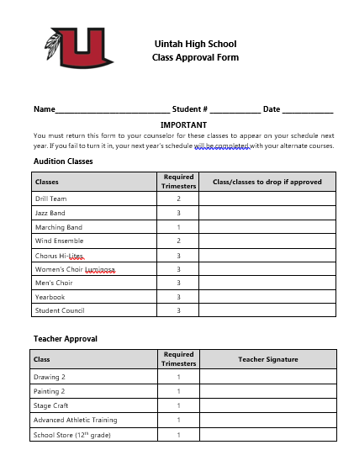

Slide 21
